Slide 1
CHAPTER 11
UNOBTRUSIVE RESEARCH

Slide 2
Reminder: Reactivity
Reactivity: A manipulation influences the measured outcome
People might act differently if they know they are being watched, might respond how they think they should respond on a survey, etc.

Slide 3
Unobtrusive Research
Unobtrusive Research – Methods of studying social behavior without affecting it.
  Types of Unobtrusive Research
    Content Analysis
    Analysis of Existing Statistics
    Comparative and Historical Analysis

Slide 4
Content Analysis
Content Analysis – The study of recorded human communications (i.e., books, websites, paintings, laws).

Slide 5
Content Analysis and Archival Research
Content analysis uses techniques of behavioral observation
  Measures the occurrence of specific events in literature, movies, television programs, or similar media presenting replicas of behaviors
Archival research looks at historical records (archives)
  Measures behaviors or events that occurred in the past

Slide 6
Content and Archival Research: Rules for Measurement
Measurement follows the same rules as used for behavioral observation
  Uses the frequency method, the duration method, or the interval method for obtaining numerical scores
  Employs multiple observers for at least part of the measurement process to obtain a measure of inter-rater reliability

Slide 7
How to measure it?
Coding in Content Analysis
  Coding – The process whereby raw data are transformed into standardized form suitable for machine processing and analysis.
  What constitutes an action/behavior? How are you going to record it?

Slide 8
Content Analysis
  Conceptualization and the Creation of Code Categories
    Operational Definition
    Levels of Measurement
  Counting and Record Keeping
    The end product of coding must be numerical!

Slide 9
Content Analysis
Steps
  Develop operational definitions
  Decide what to observe
  Decide how to code/analyze data

Slide 10
Example: Violence on TV
How would you operationalize violence?
What would you observe?
How would you code violence?

Slide 11
Content Analysis
Strengths of Content Analysis:
  Economy of time and money
  Allowing for the correction of errors
  Permits the study of processes occurring over time
  Research has little (if any) effect on subjects
  Reliability

Slide 12
Content Analysis
Weaknesses of Content Analysis:
  Limited to recorded communications
  Validity

Slide 13
Inter-Rater Reliability
How closely do two observers agree that a behavior occurred?
Cohen’s Kappa (κ)

Slide 14
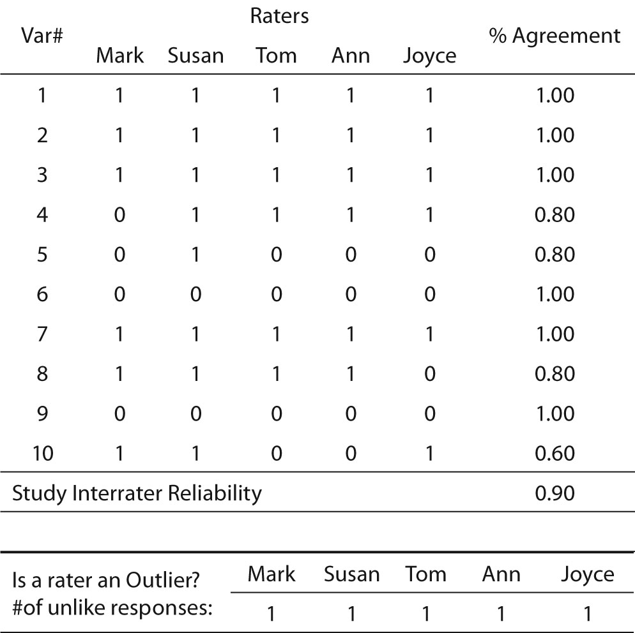

Slide 15
Inter-Rater Reliability
How closely do two observers agree that a behavior occurred?
Cohen’s Kappa (κ):
  Probably of agreement – probability of random agreement

Slide 16
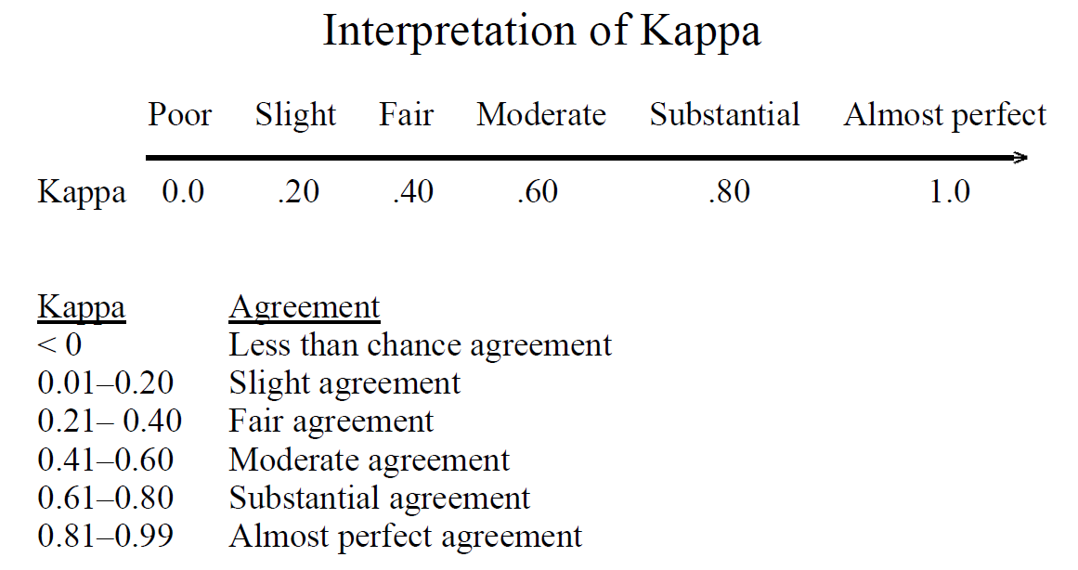
Interpreting κ

